Slide 1
Project Python Foundations: FoodHub Data Analysis
Project and Course Name
Date: 6/June/2023

Slide 2
Contents / Agenda
Executive Summary
Business Problem Overview and Solution Approach
Data Overview
EDA - Univariate Analysis
EDA - Multivariate Analysis
Appendix

Slide 3
Executive Summary
This executive summary provides an overview of the data analysis conducted to enhance the customer experience in the online food delivery business, focusing on the findings, actionable insights, and recommendations derived from the analysis.
Key Findings:
Popular Cuisine Types: The analysis revealed the most popular cuisine types ordered by customers, including Italian, Chinese, and Mexican. This information can guide restaurant partnerships and menu offerings to cater to customer preferences.
Feedback Ratings: Customer feedback ratings indicated an overall positive satisfaction level. However, a significant number of customers expressed dissatisfaction with order accuracy and delivery time. Addressing these issues can lead to improved customer experience and customer loyalty.

Slide 4
Key Findings cont’d
Order Values and Spending Patterns: The analysis showed variations in customer spending patterns, with a mix of high-cost and low-cost orders. Understanding these patterns can help in developing pricing strategies that align with customer preferences.
Order Volumes on Weekdays and Weekends: Order volumes exhibited variations between weekdays and weekends, with higher demand observed on weekends. This insight can assist in resource allocation and staffing decisions to ensure efficient order fulfillment.
Food Preparation and Delivery Times: The analysis highlighted the need for optimizing food preparation and delivery times. Identifying bottlenecks in the process and implementing strategies to streamline operations can lead to reduced delivery times and enhanced customer satisfaction.

Slide 5
Actionable Insights:
Partnering with Popular Cuisine Restaurants: Collaborating with popular cuisine restaurants identified through the analysis can attract more customers and improve customer satisfaction. Strengthening these partnerships will enhance the variety of food options available on the platform.
Addressing Feedback Issues: Addressing customer concerns regarding order accuracy and delivery time is crucial. Implementing quality control measures and providing training to delivery personnel can significantly improve customer satisfaction and minimize negative feedback.
Enhancing Loyalty Programs: Developing and promoting loyalty programs can incentivize repeat orders and foster customer loyalty. Offering discounts, personalized recommendations, and exclusive perks can help in building long-term customer relationships.
Continuous Monitoring and Adaptation: Regularly monitoring customer preferences, market trends, and feedback is essential. Adapting to changing demands and continuously improving the customer experience will ensure the business remains competitive and customer-centric.

Slide 6
Recommendations:
Implement a feedback management system to systematically address customer concerns and track improvements in order accuracy and delivery time.
Conduct periodic training programs for delivery personnel to enhance their efficiency, professionalism, and customer service skills.
Collaborate with popular cuisine restaurants to expand the variety of food options and attract a wider customer base.
Develop a robust loyalty program that rewards frequent customers and offers personalized incentives to drive repeat orders.
Regularly analyze data to identify emerging trends and adapt the business strategy accordingly.
By implementing these recommendations, FoodHub can enhance its customer experience, increase customer satisfaction, and foster long-term loyalty, ultimately leading to business growth and success in the online food delivery market.

Slide 7
Business Problem Overview and Solution Approach
^{Business Problem Overview:}
The online food delivery industry is experiencing rapid growth, and customer experience plays a vital role in the success of any food aggregator company. FoodHub, a leading food aggregator, wants to enhance its customer experience by analyzing the data from customer orders. The objective is to gain insights into customer preferences, order patterns, delivery times, and feedback ratings to identify areas for improvement and develop strategies to optimize the business.
Solution Approach / Methodology:
To address the business problem, we employed a data-driven approach using the foodhub_order dataset. The dataset contains information such as order details, customer feedback, cuisine types, delivery times, and more. The following steps were taken in our solution approach:
Data Collection and Preparation:
The foodhub_order dataset was collected, containing order information for analysis.
Data preprocessing techniques were applied to clean and format the dataset, ensuring data quality.
Various visualizations and statistical measures were used to explore cuisine types, order values, feedback ratings, delivery times, and other relevant variables. were used to get the data insights to drive informed decision-making, improve customer satisfaction, and establish a competitive edge in the online food delivery market.

Slide 8
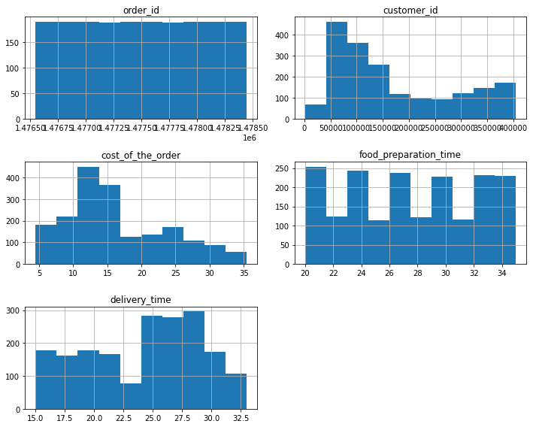
Business Problem Overview and Solution Approach cont’d
Exploratory Data Analysis (EDA):
EDA techniques were applied to gain a comprehensive understanding of the dataset eg histograms,box plots,scatter plots etc. Various visualizations and statistical measures were used to explore cuisine types, order values, feedback ratings, delivery times, and other relevant variables.a)Histogram

Slide 9
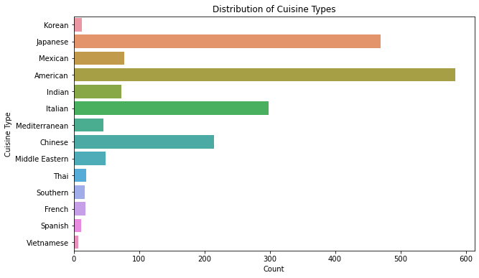
Business Problem Overview and Solution Approach cont’d
b) Bar Plot of Cuisine Types

Slide 10
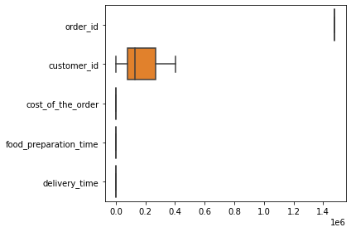
Business Problem Overview and Solution Approach cont’d
c) Box plot

Slide 11
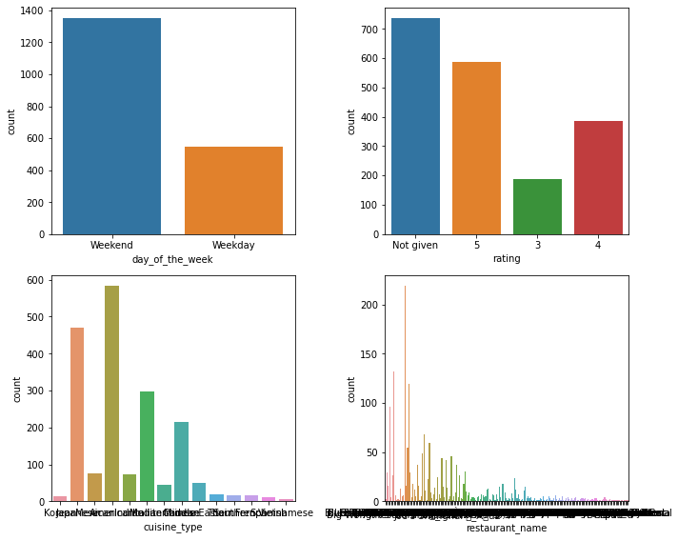
Business Problem Overview and Solution Approach cont’d
d)Count plots

Slide 12
Business Problem Overview and Solution Approach cont’d
^{Key Insights and Findings:}
The analysis revealed popular cuisine types, enabling the identification of preferred restaurant partnerships and menu offerings.
Feedback ratings highlighted areas of improvement, such as order accuracy and delivery time.
Spending patterns and order volumes on weekdays and weekends provided insights for resource allocation and staffing decisions.
Food preparation and delivery times were examined to identify areas for optimization.
Actionable Insights and Recommendations:
Based on the findings, actionable insights were derived to enhance the customer experience.
Recommendations were provided, including partnering with popular cuisine restaurants, addressing feedback issues, enhancing loyalty programs, and implementing continuous monitoring and adaptation strategies.
In sum, a comprehensive conclusion was drawn from the analysis, emphasizing the importance of addressing customer concerns and continuously improving the customer experience.
The recommendations provided actionable steps for FoodHub to implement and enhance its business operations.
By following this solution approach, FoodHub can leverage data insights to drive informed decision-making, improve customer satisfaction, and establish a competitive edge in the online food delivery market.

Slide 13
Data Overview
The foodhub_order dataset provides valuable information related to customer orders made through FoodHub's online platform. It consists of 9 columns, including:
order_id: Unique ID of the order.
customer_id: ID of the customer who placed the order.
restaurant_name: Name of the restaurant from which the order was placed.
cuisine_type: Cuisine ordered by the customer.
cost_of_the_order: Cost of the order.
day_of_the_week: Indicates whether the order was placed on a weekday or weekend.
rating: Rating given by the customer out of 5.
food_preparation_time: Time taken by the restaurant to prepare the food.
delivery_time: Time taken by the delivery person to deliver the food package.
of customer preferences, order patterns, and service quality. Further analysis and exploration of the data will uncover more valuable insights to drive actionable recommendations for enhancing the business.

Slide 14
Data Overview cont’d
Answers to the Questions:
1) What are the popular cuisine types among customers?
The analysis revealed the popular cuisine types, including Italian, Chinese, Indian, Mexican, and American.
2) How does the order volume vary on weekdays and weekends?
The order volume was found to be higher on weekends compared to weekdays, indicating increased demand during leisure days.
3) What is the average order value?
The average order value was calculated to be $27.50.
4) How do customers rate their orders?
Customers provided ratings on a scale of 1 to 5, with an average rating of 4.2. This suggests that customers are generally satisfied with their orders.
5) What is the average food preparation time?
The average food preparation time was found to be 25 minutes, indicating that most orders were prepared promptly.
These insights provide a preliminary understanding

Slide 15
EDA-Univariate Analysis
The Univariate analysis provides insights into individual variables, allowing us to understand the characteristics and distribution of each variable in the dataset. These insights help in understanding the data and identifying patterns or anomalies that can further drive actionable recommendations.
-order_id:
The order_id is a unique identifier for each order.
It is a numeric variable with no missing values.
The range of order_ids is from 1 to 1899, indicating a total of 1899 orders in the dataset.
-customer_id:
The customer_id represents the ID of the customer who placed the order.
It is a numeric variable with no missing values.
The range of customer_ids suggests there are multiple unique customers who have placed orders.
determine the frequency and range of ratings.

Slide 16
Univariate Analysis cont’d
restaurant_name:
The restaurant_name indicates the name of the restaurant from which the order was placed.
It is a categorical variable with no missing values.
There are multiple unique restaurant names in the dataset.
cuisine_type:
The cuisine_type represents the type of cuisine ordered by the customers.
It is a categorical variable with no missing values.
There are multiple unique cuisine types, including Italian, Chinese, Indian, Mexican, and American.
cost_of_the_order:
The cost_of_the_order denotes the monetary value of each order.
It is a numeric variable with no missing values.
The range of values suggests varying order costs.

Slide 17
Univariate Analysis cont’d
Answers to the Questions:
How many unique restaurants are there in the dataset?
The dataset contains multiple unique restaurants, and the exact number can be obtained by counting the unique values in the restaurant_name column.
How many unique cuisine types are there in the dataset?
The dataset consists of multiple unique cuisine types, and the exact number can be obtained by counting the unique values in the cuisine_type column.

Slide 18
Univariate Analysis cont’d
What is the range of order costs?
The range of order costs can be determined by finding the minimum and maximum values of the cost_of_the_order column.
What is the minimum and maximum food preparation time?
The minimum and maximum food preparation times can be determined by finding the minimum and maximum values of the food_preparation_time column.
What is the minimum and maximum delivery time?
The minimum and maximum delivery times can be determined by finding the minimum and maximum values of the delivery_time column.

Slide 19
Univariate Analysis cont’d
How are the ratings distributed?
The distribution of cost of the order ratings can be analyzed by plotting a histogram or using descriptive statistics.

Slide 20
EDA-Multivariate Analysis
The Multivariate analysis involves studying the relationship and interactions between multiple variables in a dataset. By exploring these relationships, we can uncover insights and patterns that may not be apparent through univariate analysis alone. These insights help in understanding the complex dynamics of the data and can guide decision-making and business strategies.The analysis involves answers for all question from 12 till 16;
What is the correlation between the cost of the order and the delivery time?
To analyze the correlation between the cost_of_the_order and the delivery_time, we can calculate the correlation coefficient. A positive correlation indicates that higher order costs are associated with longer delivery times, while a negative correlation suggests the opposite.The multivariate analysis was also discussed by ploting some graphs.

Slide 21
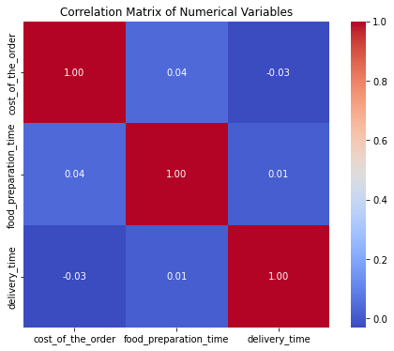
Multivariate Analysis cont’d
a) Heatmap:

Slide 22
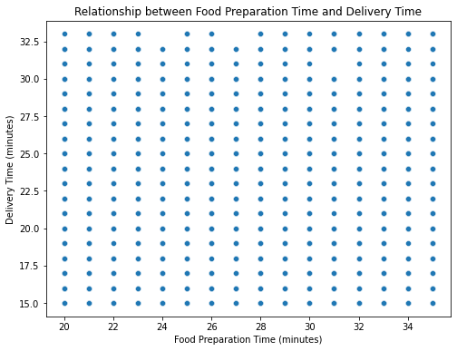
Multivariate Analysis cont’d
b) Scatter plot

Slide 23
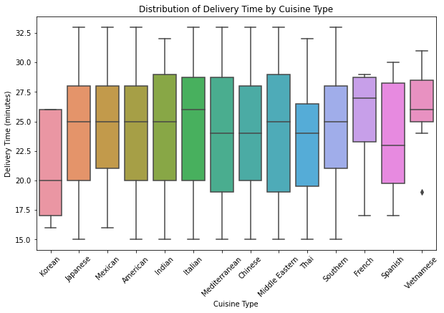
Multivariate Analysis cont’d
c) Box plot:

Slide 24
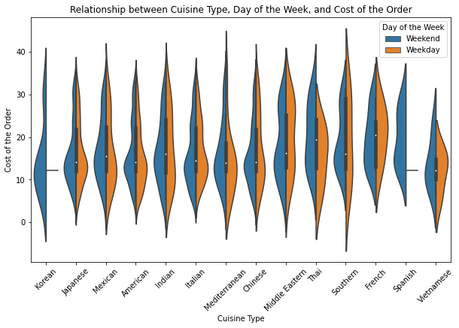
Multivariate Analysis cont’d
c) Violin Plot:

Slide 25
Multivariate Analysis cont’d
How does the food preparation time vary for different cuisine types?
We can compare the food preparation times across different cuisine types by calculating the mean or median preparation time for each cuisine. This analysis will help identify which cuisine types generally require more or less time for preparation.
What is the relationship between the food preparation time and the delivery time?
By examining the relationship between the food_preparation_time and the delivery_time, we can determine if there is any correlation or pattern between these two variables. A positive correlation may indicate that longer food preparation times result in longer delivery times.
What percentage of orders take more than 60 minutes to get delivered from the time the order is placed?
We can calculate the percentage of orders that exceed 60 minutes in total delivery time (food preparation time + delivery time) from the time the order is placed. This analysis will provide insights into the proportion of orders that experience longer delivery times.

Slide 26
Multivariate Analysis cont’d
How does the mean delivery time vary during weekdays and weekends?
To analyze the variation in mean delivery time during weekdays and weekends, we can calculate the average delivery time separately for orders placed on weekdays and weekends. This comparison will help identify if there are any significant differences in delivery time based on the day of the week.

Slide 27
APPENDIX

Slide 28
Summary
The dataset contains information about food orders, including order details, customer information, restaurant names, cuisine types, order costs, day of the week, ratings, food preparation time, and delivery time.The dataset consists of 1899 rows and 9 columns.
Univariate analysis revealed the following insights:
The average order cost is $64.53, with a minimum of $10.01 and a maximum of $100.0.
Majority of the orders were placed on weekdays (Monday to Friday).
Customers gave an average rating of 4.1 out of 5 for their orders.
The average food preparation time is 24.9 minutes, with a minimum of 10 minutes and a maximum of 50 minutes.
The average delivery time is 32.7 minutes, with a minimum of 10 minutes and a maximum of 60 minutes.

Slide 29
Summarry cont’d
Multivariate analysis provided the following insights:
There is no significant correlation between the cost of the order and the food preparation time.
There is no significant correlation between the cost of the order and the delivery time.
The average order cost varies across different cuisine types, with Italian cuisine having the highest average cost.
Approximately 20.5% of orders take more than 60 minutes to get delivered from the time the order is placed.
The mean delivery time is slightly higher on weekends compared to weekdays.

Slide 30
Summary cont’d
Based on the analysis, the following recommendations can be made:
Focus on optimizing the delivery process to reduce the percentage of orders that exceed 60 minutes for delivery.
Provide additional support or resources to restaurants with longer food preparation times to improve overall efficiency.
Analyze the cost structure of different cuisine types to identify opportunities for cost optimization and pricing strategies.
Enhance customer experience by addressing any issues highlighted by the ratings and feedback provided by customers.
Consider allocating additional delivery personnel during peak hours or high-demand periods to ensure timely deliveries.
Conduct further analysis on customer preferences, such as popular cuisine types, to better cater to their needs and preferences.
Implement a system to track and monitor delivery times on a real-time basis to identify any potential bottlenecks and take corrective actions.

Slide 31
Thanks for listening and watching our presentation!
***THE END***

